Slide 1

S.Q.U.I.D.S Where They Now?
- Courtney cowper

Slide 2
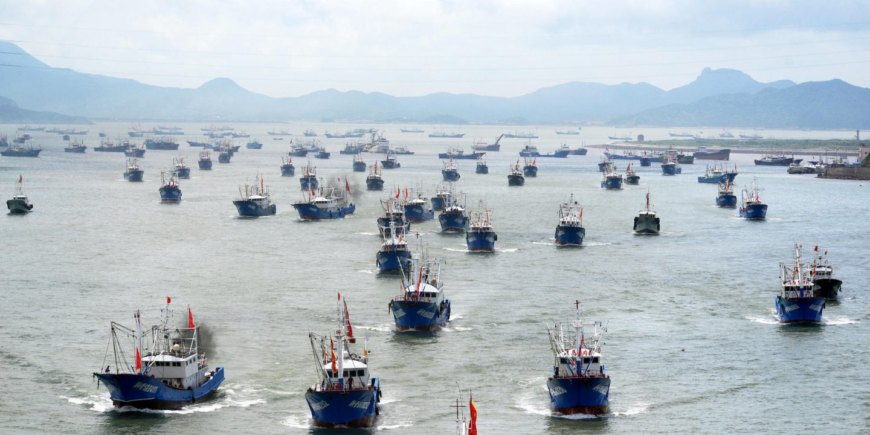
Can we quantify the impact of illegal, unreported and unregulated fishing?

Slide 3
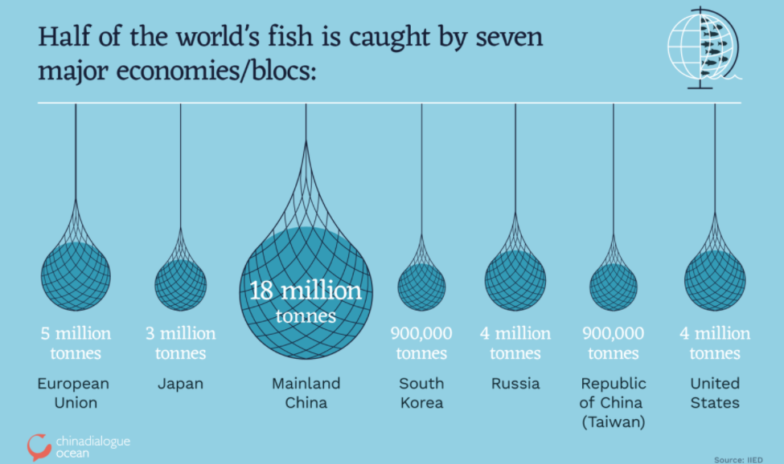
Data compiled from 2018 FAO reported wild catch

Slide 4



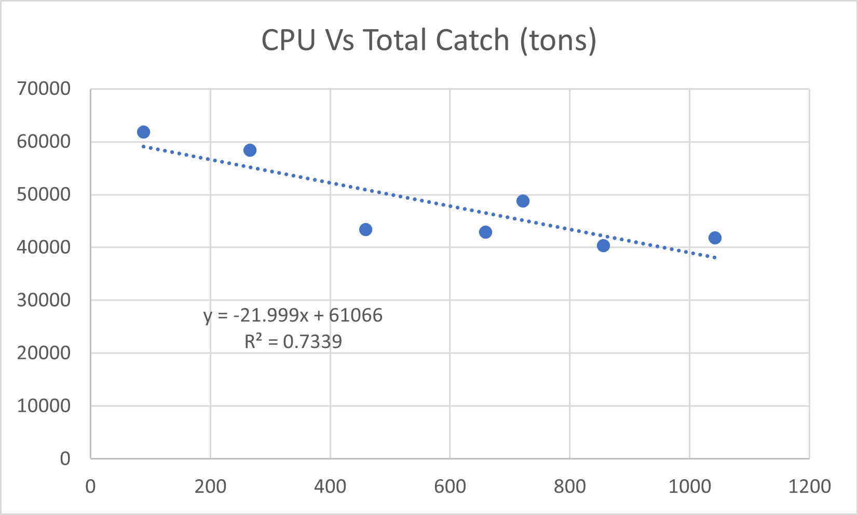
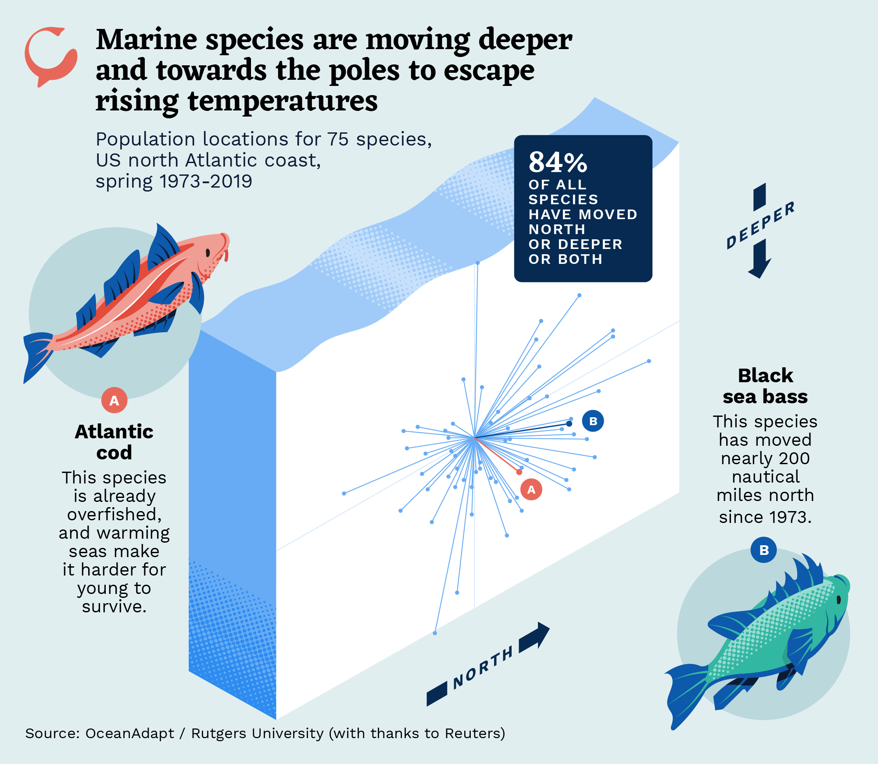
Methodology

Slide 5
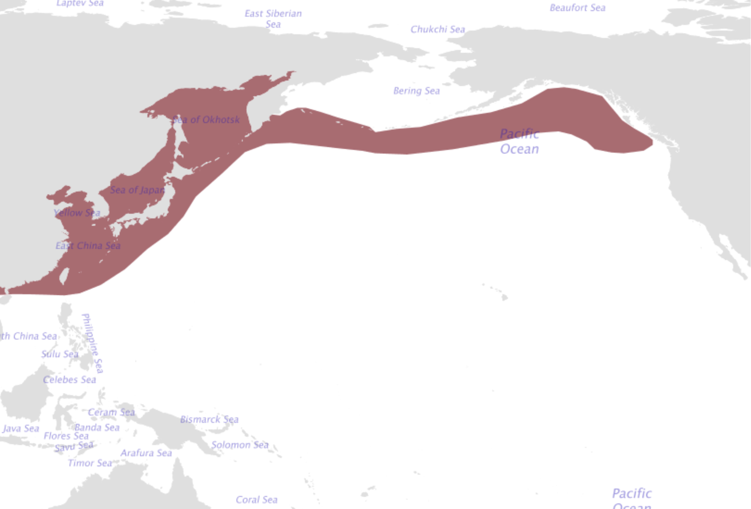

Slide 6
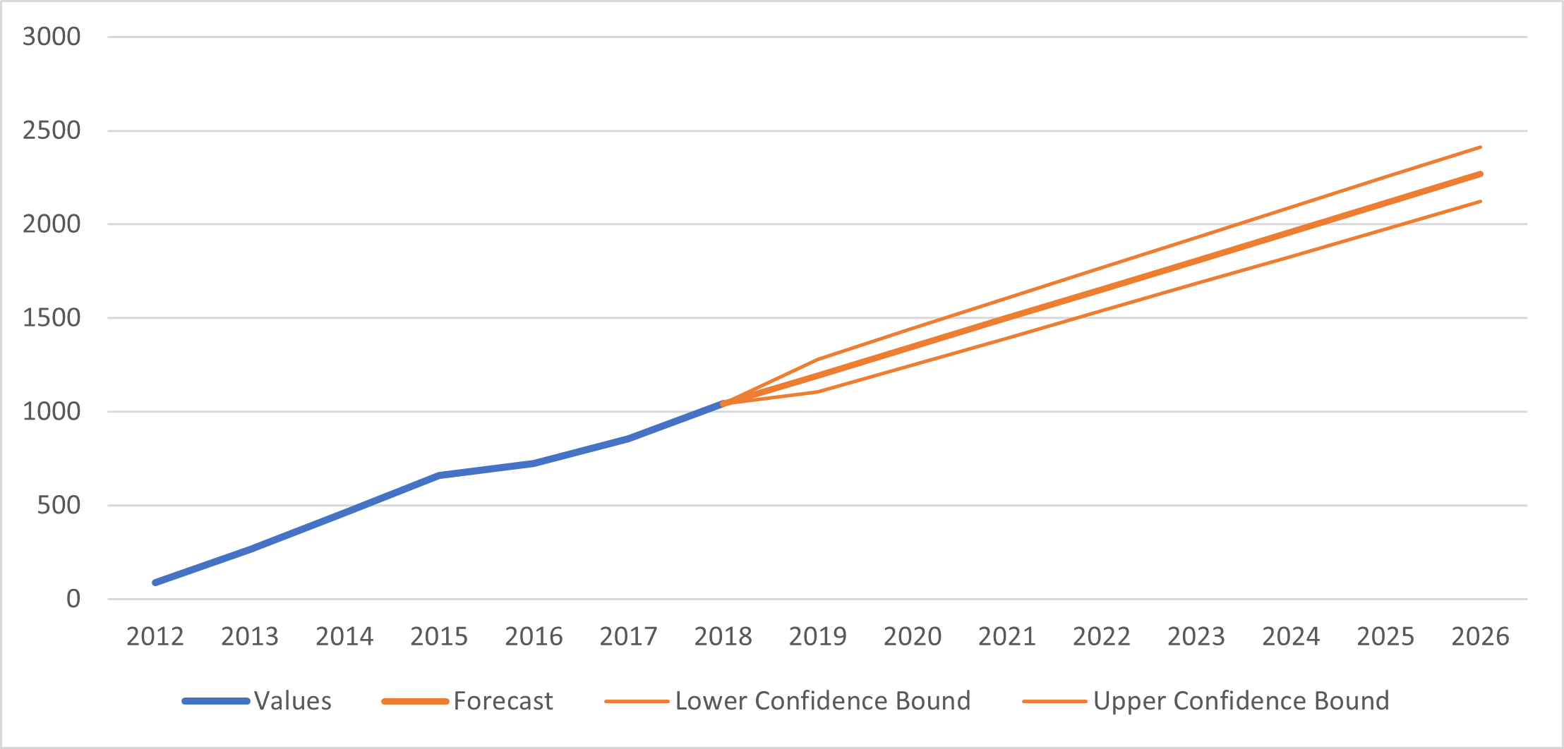
Projected fishing effort
Chinese fishing effort of squid jigging vessels from 2012 to 2018 in blue, forecasted effort in orange.

Slide 7
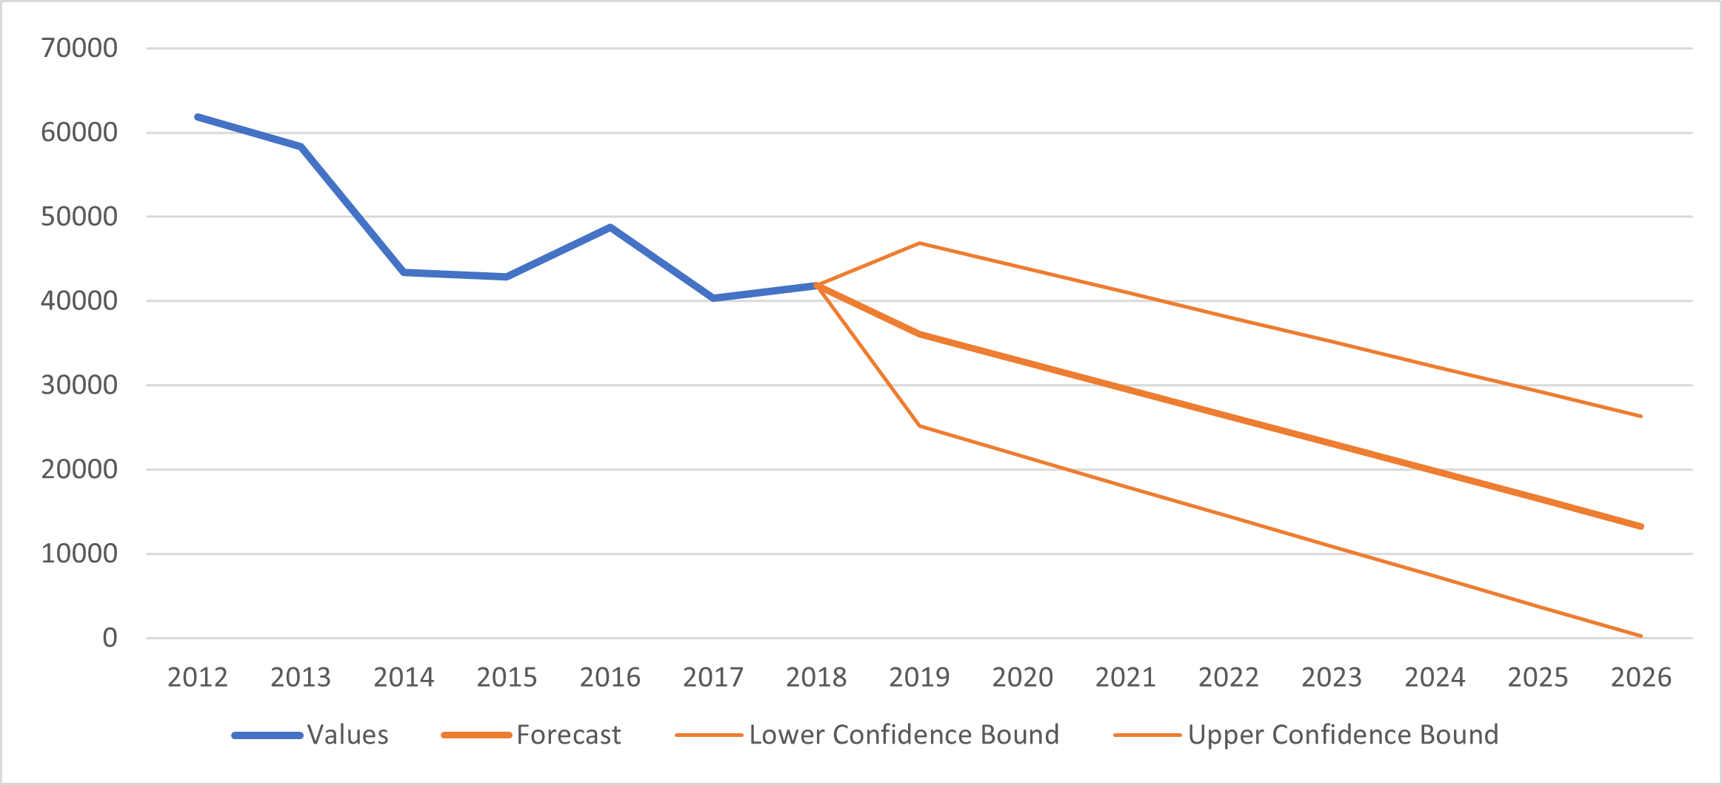
Total catch of squid in the next 5 years

Slide 8
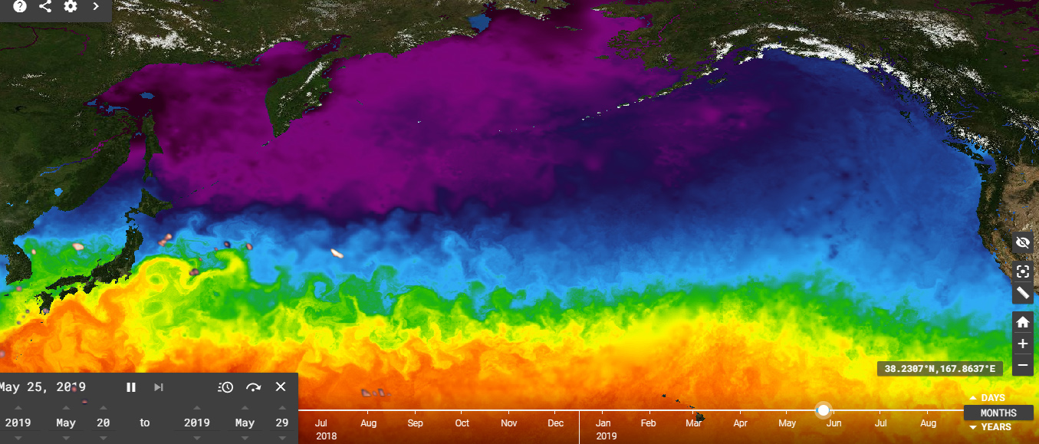
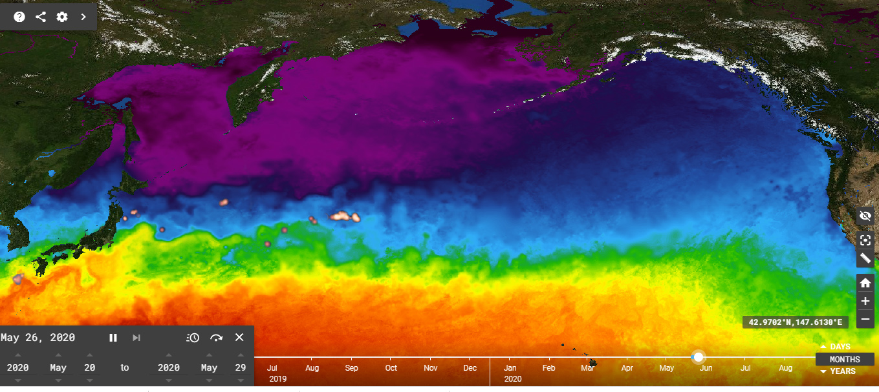
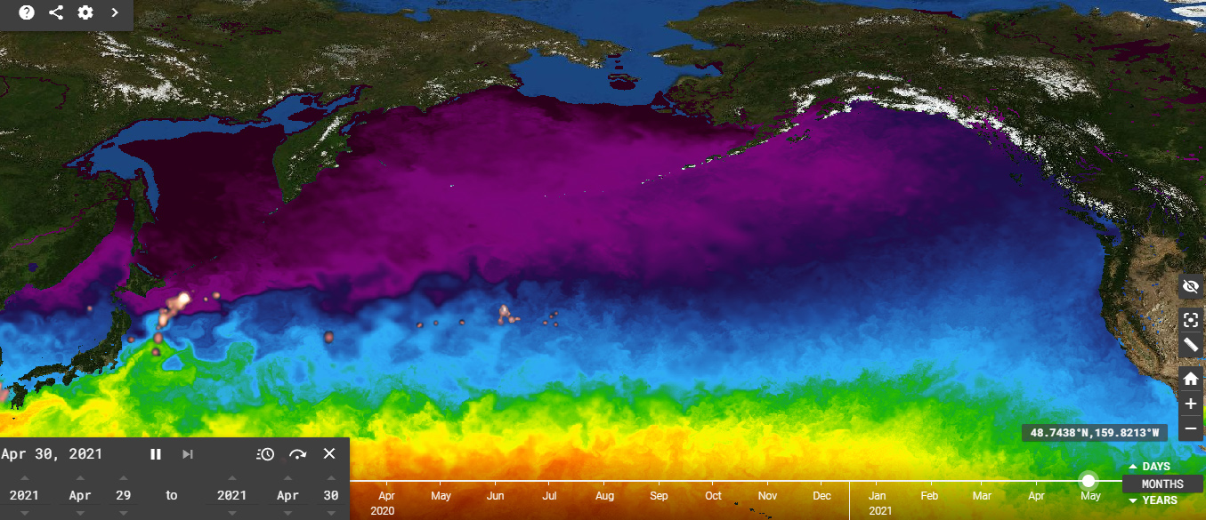

Slide 9
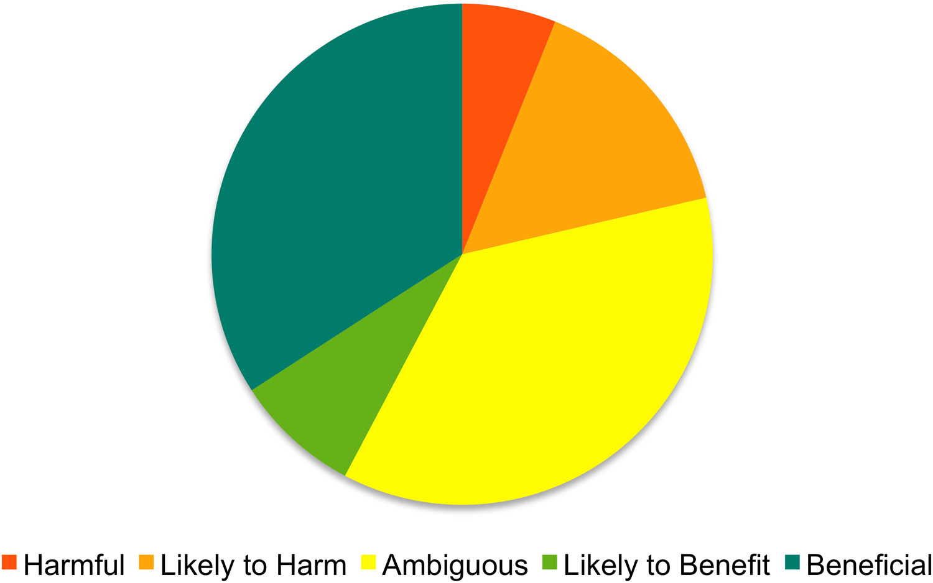
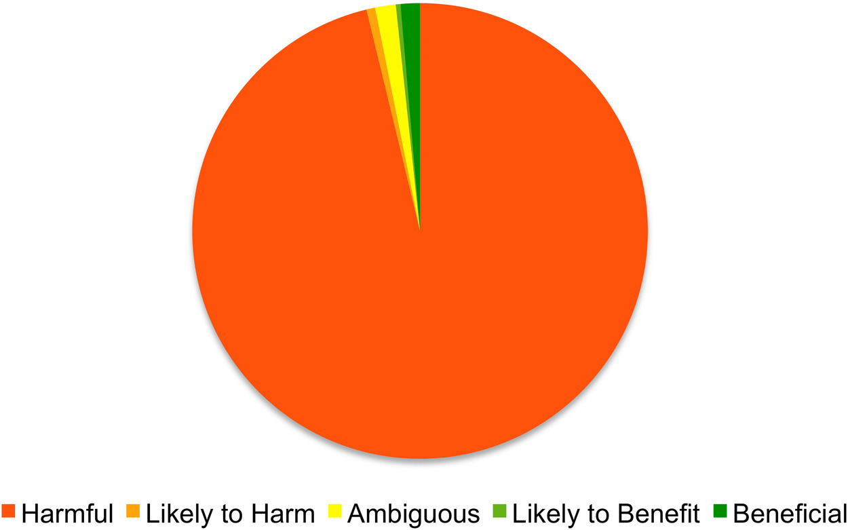
China provided $6.5 billion in subsidies to its fishing industry in 2013. In 2018, it was estimated to be 7.2 billion.
Most of China's fishery subsidies, 94 percent, are fuel subsidies
About 95 percent of China's fishery subsidies were harmful to sustainability.
China's growing domestic consumption is slated to account for 38 percent of global consumption by 2030

Slide 10
China leverages subsidies and under-reporting to gain competitive advantage, while threatening a shared marine resource.
China squid fishing will expand to the East, while maintaining aggressive behavior, and secretive tactics…
Questions?

